Slide 1

SVKM’s Institute of Technology, Dhule Department of Information Technology
Project Presentation
On
“Real time Prediction of Sugar level using Sweat through Blood Sugar Level Band”
By
42. Atharva Nandkishor Pingale
53. Rohan Manoj Tawar
55. Aniket Prakash Wakle
60. Dhiraj Mahendra Patil
Guide
Mr. Sachin Kamble

Slide 2
Contents
Project Group
Project Motivation
Problem Statement
Objectives Of Project
Introduction
Architecture
Implementation
Survey
Hardware
References

Slide 3
Project Details
Project Title : Real time Prediction of Sugar level using Sweat through Blood Sugar Level Band
Project Group Members:
T2054491246008 Atharva Nandkishor Pingale
T2054491246006 Aniket Prakash Wakle
T2054491246047 Rohan Manoj Tawar
T2054491246015 Dhiraj Mahendra Patil

Slide 4
Motivation
According to medical survey there one and two patient in every home who is dealing with sugar diabetes and every time they need to check blood for sugar level which is painful to over come this we came up with the idea of BSL Band

Slide 5
Problem statement
In Public health and surveillance there is need for better surveillance methods or tools in public health care to measure and track blood sugar level of patient as they can be unconscious if the blood sugar level is down or up significantly. Sweat contains glucose that can accurately reflect blood glucose. However skin surface glucose can confound these measurements.

Slide 6
Objectives of the Project
• To overcome daily painful blood sugar level measurement.
• To keep track of the patient sugar level and his daily diet.
• Provide accurate information as other traditional methods of blood sugar level calculation.

Slide 7
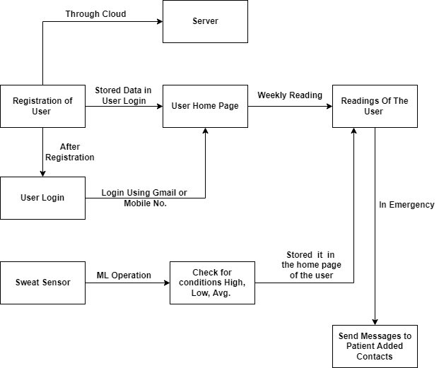
Architecture
.

Slide 8

Implementation

Slide 9
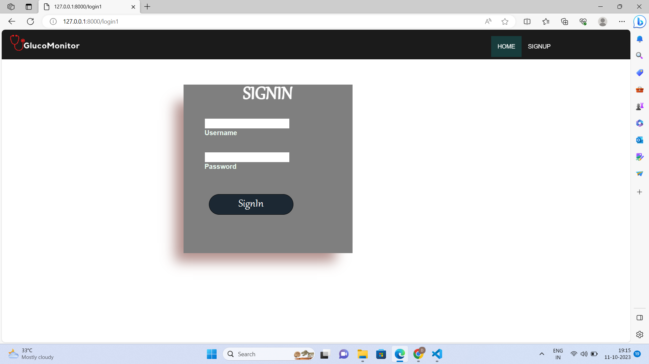
Implementation

Slide 10
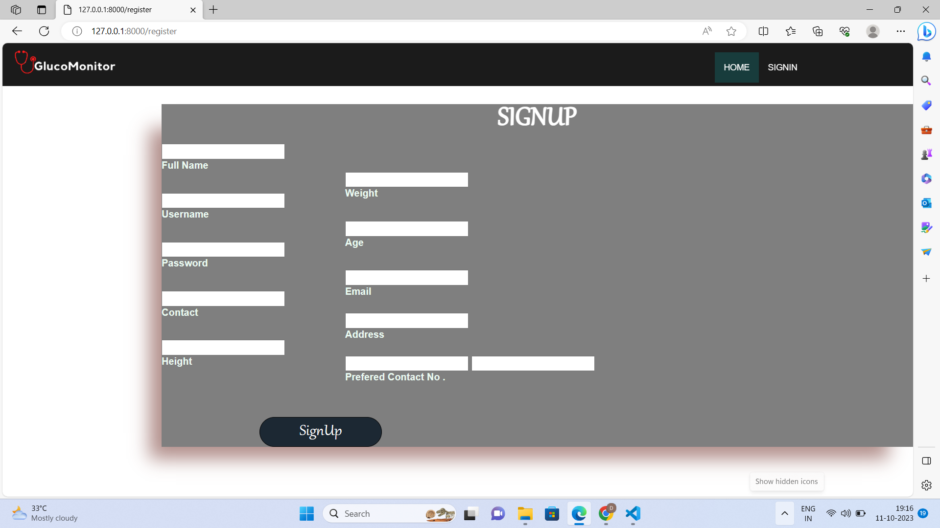
Implementation

Slide 11
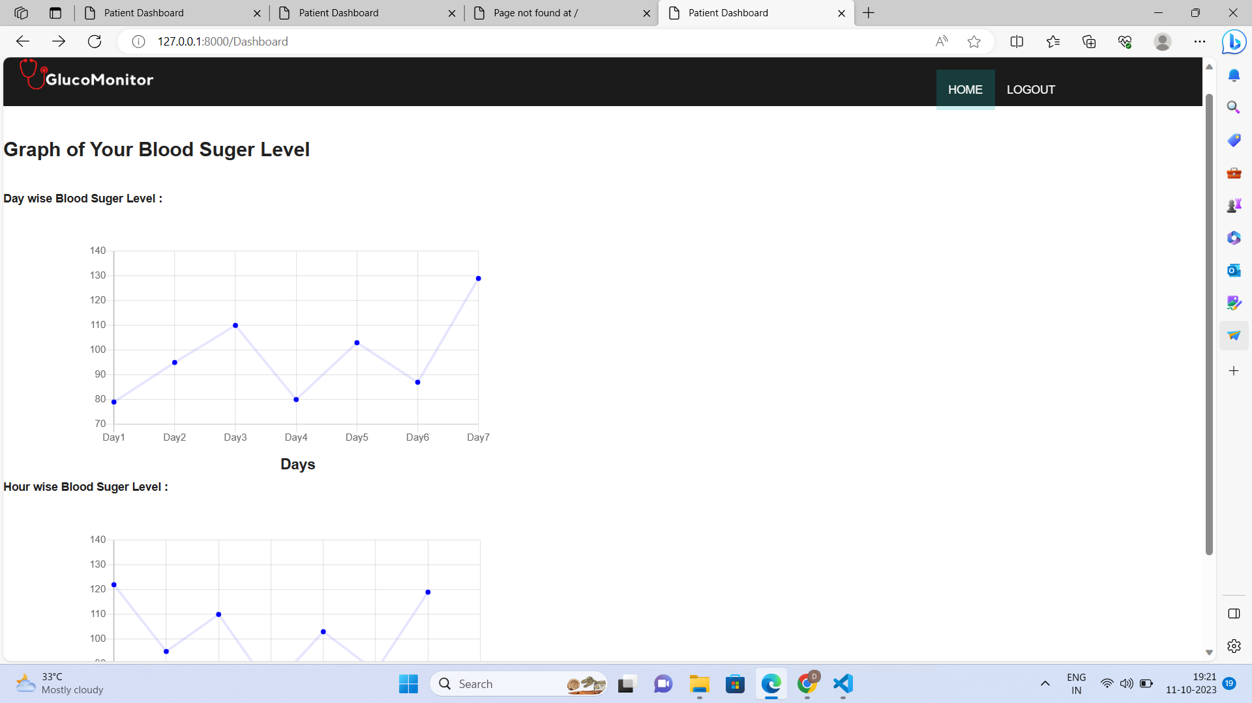
Implementation

Slide 12
Survey
Visit :
1. Dr. Shashikant Bajbalkar(BAMS)
Shri Dhanvantari Clinic, Panvel
2. Dr. Bhanudas Patil(BHMS) Rg.No.9182
Mahalakshmi Clinic(Mohadi), Dhule
3. Dr. Abhijeet Zende(MD/Orthopaedic Surgeon)
Zende Hospital, Dhule
4. Dr. Pradip Shah(MD/Heart Specialist)
Fortis Hospital, Mulund West, Mumbai
5. Dr. Sandip Bhavsar(MD)
Sai Hospital, Deopur, Dhule

Slide 13
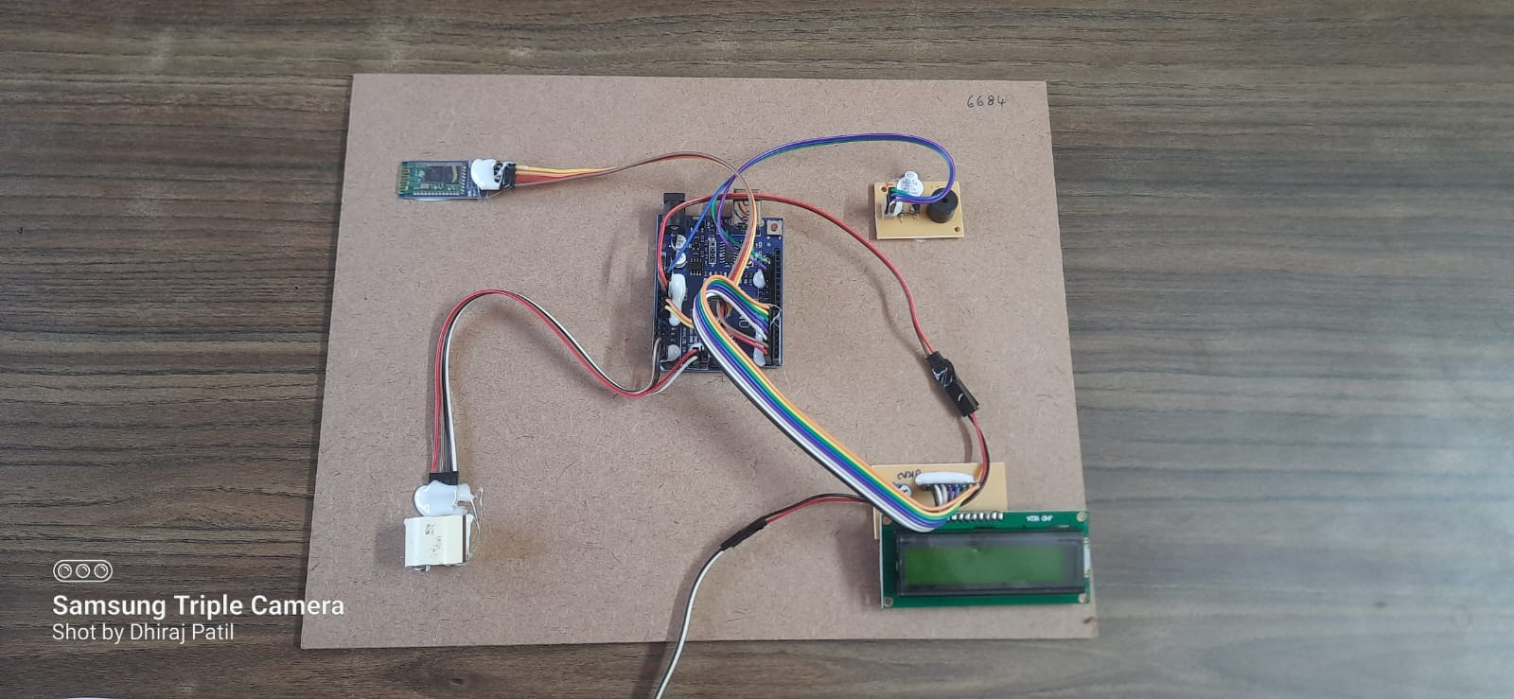
Hardware

Slide 14
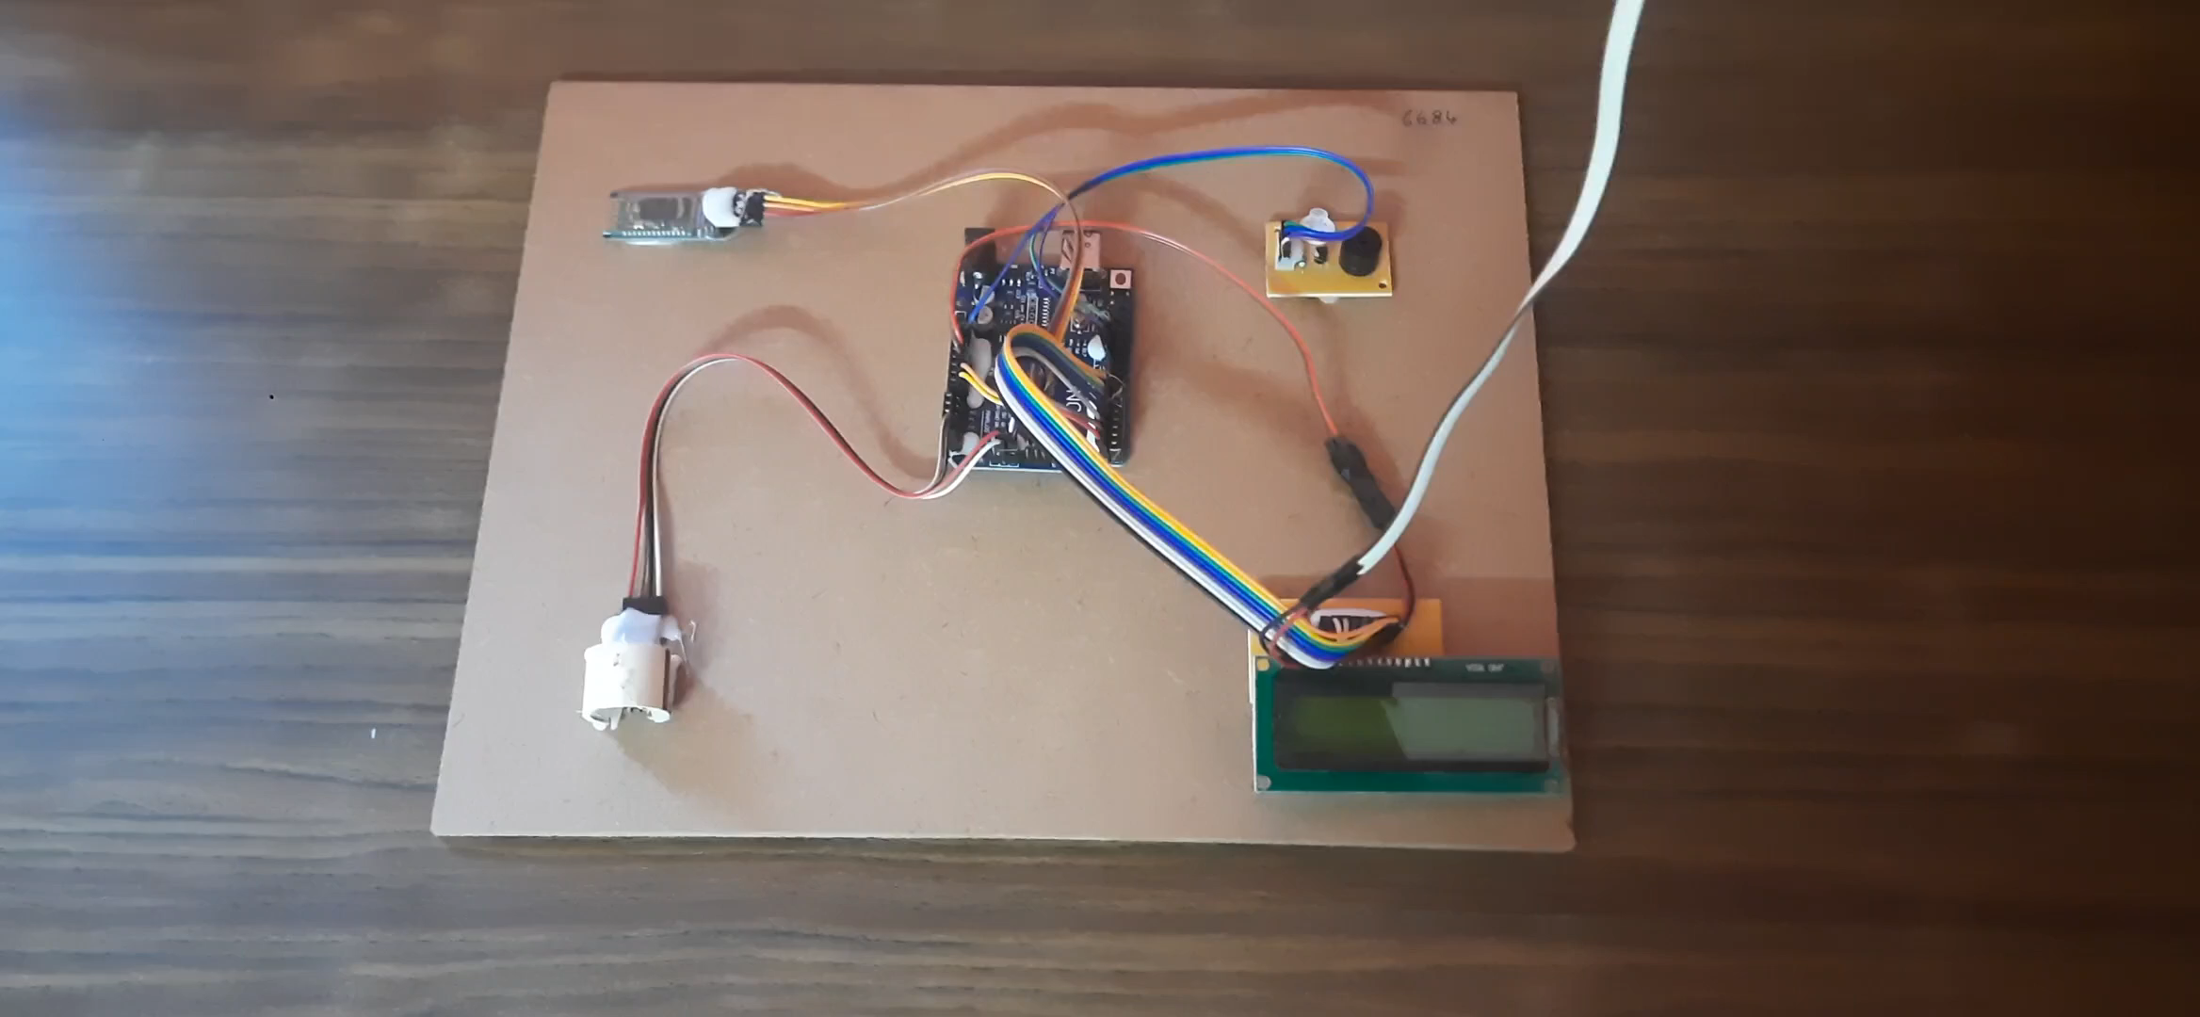
Hardware

Slide 15
References
[1] Maryamsadat Shokrekhodaei, David P. Cistola, Robert C. Roberts, and Stella Quinones, “Non-Invasive Glucose Monitoring Using Optical Sensor and Machine Learning Techniques for Diabetes Applications,” in IEEE, vol. 9,2021.
[2] Shilpa C Venugopal and Sruthi M, “Pre-Prediction of Diabetes and Sweat based real time Glucose monitoring system,” International Journal of Applied Engineering Research ISSN 0973-4562 Volume 1, Number 1, 2020.
[3] Esther Renner, Nadine Lang, Bernd Langenstein, Matthias Struck and Thomas Bertsch, “Validating sweat ammonia as physiological parameter for wearable devices in sports science,” in IEEE 2020.
[4] Dr. B. Sargunam and S. Anusha, “IoT Based Mobile Medical Application for Smart Insulin Regulation,” in IEEE 2019.

Slide 16
Question & Answer

